Slide 1
Gradient Descent and its variants for least square or linear regression
Phuc Loi Luu, PhD
luu.p.loi@googlemail.com
p.luu@garvan.org.au

Slide 2
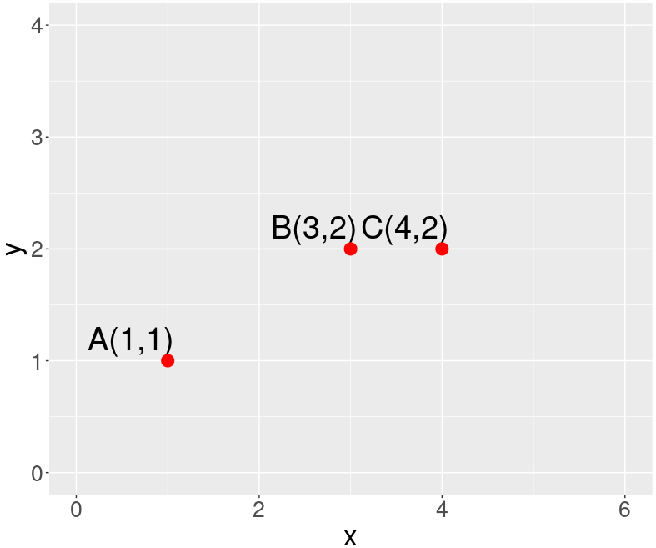
Level 1: scalar variable to derive the derivative by hand and plug in gradient descent function
function: y = mx + c at A(1,1), B(3,2), C(4,2)
e_{C}
e_{B}
e_{A}

Slide 3
Level 1: scalar variable to derive the derivative by hand and plug in gradient descent function
y_{h} = mx + c
e² = (y_{h} - y)² = (mx+c - y)²
=> e²_{total} = e²_{A} + e²_{B} + e²_{C}
= (m + c - 1)² + (3m + c - 2)² + (4m + c - 2)²
= c²+m²-2m+2cm-2c+1+c²+9m²-12m+6cm
-4c+4+c²+16m²-16m+8cm-4c+4
= 26m²+3c²-30m+16cm-10c+9
d(e²_{total})/dm = 52m + 16c - 30
d(e²_{total})/dc = 16m + 6c - 10
Gradient descent
m = m - rate*d(e²_{total})/dm
c = c - rate*d(e²_{total})/dc
e_{C}
e_{B}
e_{A}

Slide 4
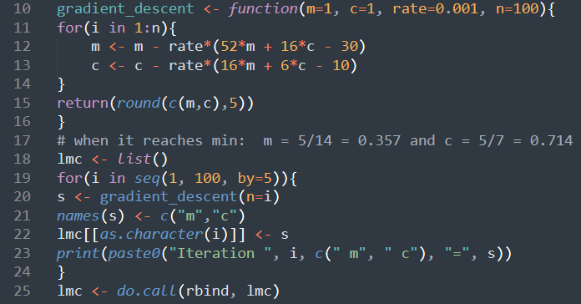

Slide 5
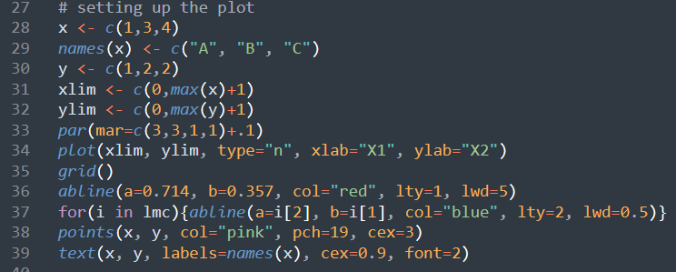

Slide 7

Level 2: vector form
y = m*x + c
E = (y_{h} - y)² = (m*x + c - y)²
dE/dm = 2*(m*x + c - y)*x
dE/dc = 2*(m*x + c - y)
A <- matrix(c(1,3,4,1,1,1), nrow=3, ncol=2)
[,1] [,2]
[1,] 1 1
[2,] 3 1
[3,] 4 1
1 | 1
3 | 1
4 | 1
1
2
2
m
C
=
$$Ax=b$$

Slide 8
Level 2: vector form
Three points: A(1,1), B(3,2), C(4,2) for y = m*x + c
E = e²_{total} = (y_{h} - y)² = e²_{A} + e²_{B} + e²_{C}
= (m + c - 1)² + (3m + c - 2)² + (4m + c - 2)²
= c²+m²-2m+2cm-2c+1+c²+9m²-12m+6cm-4c+4+c²+16m²-16m+8cm-4c+4
= 26m²+3c²-30m+16cm-10c+9
d(e²_{total})/dm = 52m + 16c - 30
d(e²_{total})/dc = 16m + 6c - 10
E = e²_{total} = (y_{h} - y)² = (m*x + c - y)²
dE/dm = 2(mx + c - y)x
= 2(m + c - 1) + (3m + c - 2)3 + (4m + c - 2)4
dE/dc = 2(mx + c - y)
= (m + c - 1) + (3m + c - 2) + (4m + c - 2)
y = m*x + c
E = (y_{h} - y)² = (m*x + c - y)²
dE/dm = 2*(m*x + c - y)*x
dE/dc = 2*(m*x + c - y)

Slide 9
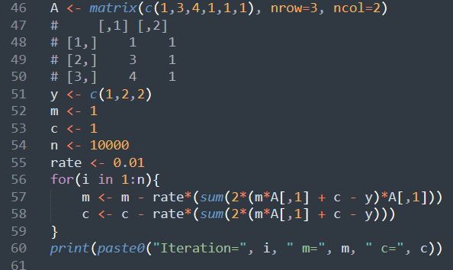

Slide 10
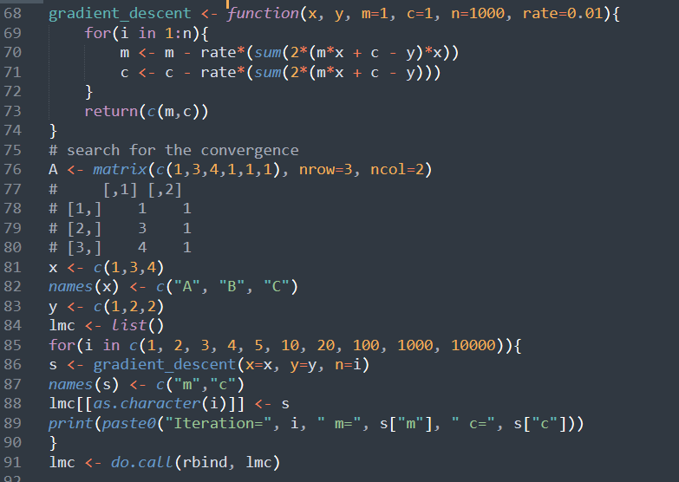
Level 2: vector form and make function

Slide 11
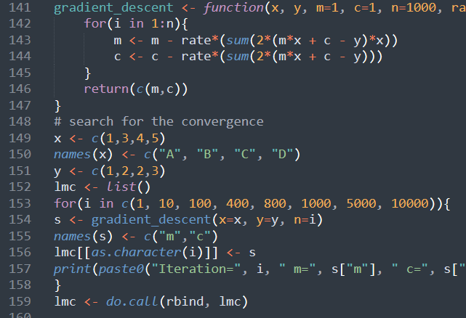
Level 3: vector form to make function with any data for simple linear regression

Slide 13
Level 4: matrix form to make function with different data for multiple linear regression
y = m1*x1 + m2*x2+ c with 3 points in the form P(x1, x2, y): A(1,3,1), B(3,7,2) and C(4,5,2)
y_{A} = m₁*x_{1A} + m₂*x_{2A} + c = m₁ + 3m₂ + c
y_{B} = m₁*x_{1B} + m₂*x_{2B} + c = 3m₁ + 7m₂ + c
y_{C} = m₁*x_{1C} + m₂*x_{2C} + c = 4m₁ + 5m₂ + c
y = Am
Least Square Error (LSE) = (y_{line}-y)² = (Am-y)²
dLSE/dm = 2(Am-y)A

Slide 14
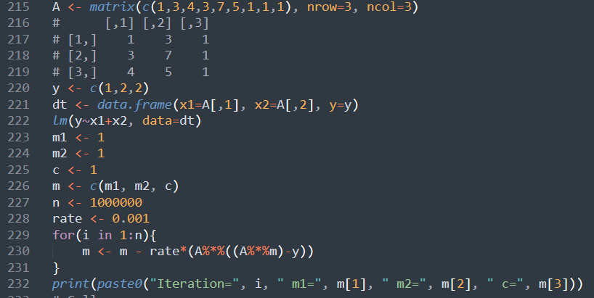

Slide 15
Use lm function in R
Call:
lm(formula = y ~ x1 + x2, data = dt)
Coefficients:
(Intercept) x1 x2
0.375 0.250 0.125
# [1] "Iteration=1000000 m1=0.25000000000003 m2=0.12499999999998 c=0.37500000000004"

Slide 16
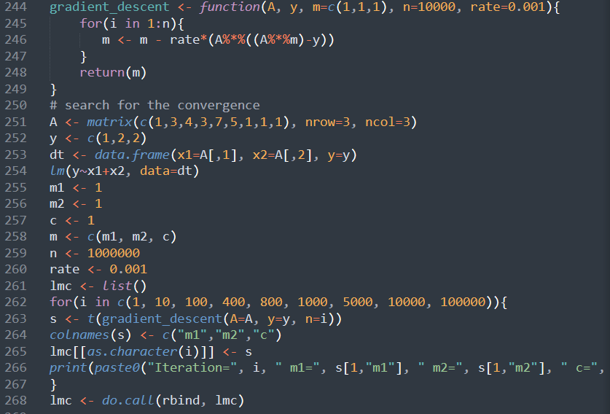

Slide 17
Stochastic Gradient Descent
Three points: A(1,1), B(3,2), C(4,2) for y = m*x + c
E = e²_{total} = (y_{h} - y)² = e²_{A} + e²_{B} + e²_{C}
= (m + c - 1)² + (3m + c - 2)² + (4m + c - 2)²
= c²+m²-2m+2cm-2c+1+c²+9m²-12m+6cm-4c+4+c²+16m²-16m+8cm-4c+4
= 26m²+3c²-30m+16cm-10c+9
d(e²_{total})/dm = 52m + 16c - 30
d(e²_{total})/dc = 16m + 6c - 10
E = e²_{total} = (y_{h} - y)² = (m*x + c - y)²
dE/dm = 2(mx + c - y)x = 2(m + c - 1) + (3m + c - 2)3 + (4m + c - 2)4
dE/dc = 2(mx + c - y) = (m + c - 1) + (3m + c - 2) + (4m + c - 2)
Batch gradient descent
m = m - rate* dE/dm
c = c - rate* dE/dc
Stochastic gradient descent
Let say we have sample a random list of data as A, B and C
Repeat n=100:
A(1,1)
m_{A} = m₀ - rate* dE_{A}/dm
c_{A} = c₀ - rate* dE_{A}/dc
B(3,2)
m_{AB} = m_{A} - rate* dE_{B}/dm
c_{AB} = c_{A} - rate* dE_{B}/dc
C(4,2)
m_{ABC} = m_{AB} - rate* dE_{C}/dm
c_{ABC} = c_{C} - rate* dE_{C}/dc

Slide 18
Stochastic Gradient Descent
No. | Gradient descent method | Number of samples | Number of used samples
1 | Batch Gradient Descent | n | n
2 | Stochastic Gradient Descent | n | 1
3 | Mini-batch Gradient Descent | n | 1<m<n

